Slide 1


Slide 2

Notes:
Meet Wally! Australia’s Top Model, posing for pictures with tourists like me
In 2017, I had the privilege of visiting the International Symposium of Forecasters, in Cairns, Australia,
close to the Great Barrier Reef, as a SPEAKER.

Slide 3
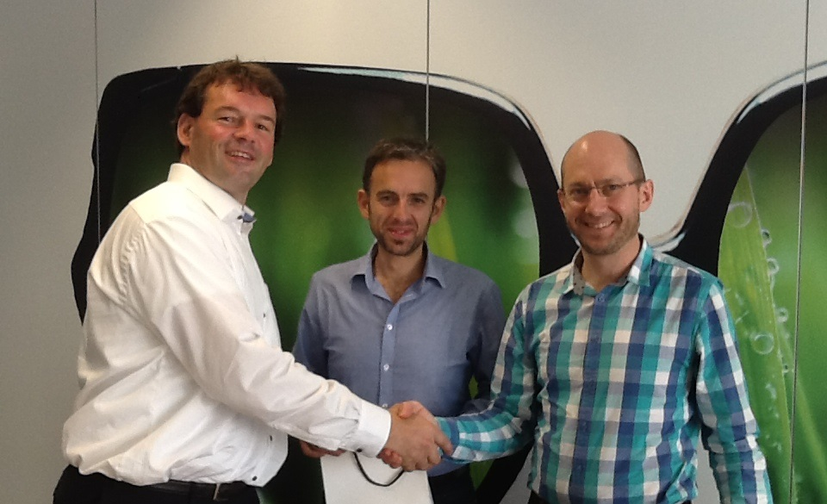
Notes:
Months prior, we partnered with Professor Hyndman and his team
to apply hierarchical forecasting techniques
Unfortunately, we had a mix bag of results, due to data challenges

Slide 4
Trust
is all you need
Notes:
During a coffee break with Michael Gilliland, I shared my data frustrations, he replied,
"It's not just about having good data and robust models. but also, user trust.
Trust is all you need!"

Slide 5
Forecast Value Add
75%
Source: Fildes & Goodwin, “Good and Bad Judgment in Forecasting.” Foresight, Fall 2007.
Notes:
He cited a study analyzing 60,000 forecasts, which found that only 25% remained untouched.
Large adjustments often improved accuracy, while small tweaks either had no effect or reduced accuracy.
These adjustments, referred to as forecast value add, are the main focus of my research

Slide 6


Notes:
Today, I’m excited to share my journey to improve forecast accuracy at Ecotone
We produce ‘food for biodiversity’,
good for Humans,
good for Animals,
good for the Planet.
My Project: Pythia’s Advice!

Slide 7
problem statement
Notes:
So, what problem am I trying to solve?
My goal is to reduce unnecessary and negative adjustments by
providing a benchmark to show how well forecasts work without them.

Slide 8
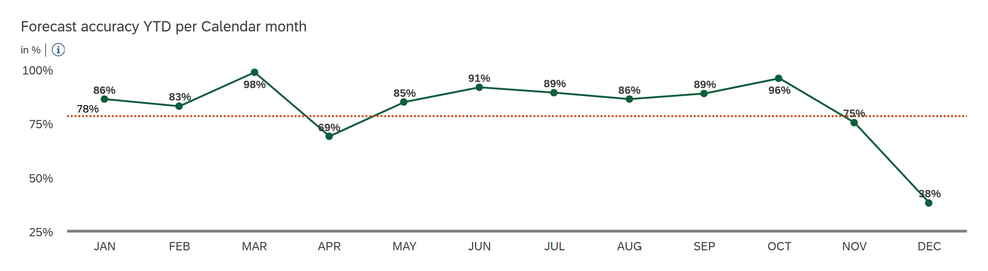

Was?
current inefficiencies in data, models & trust!
Adjustments
Overrides
Consensus
Final
Accuracy
X%
Forecast
Value Add
Forecast
(Seasonal) Naïve
(Moving) average
Exp. smoothing
Arima
Forecast
Data
Master data
Sales history
Promotions
Stock levels
Cleaning
Outliers
Stock outs
Sales -> Demand
Forecast Cost
Notes:
Let’s explore how the process relates to accuracy, as shown on the y-axis.
The orange dot represents our current performance, the x-axis representing cost.
The process starts with data collection, followed by data cleaning to turn sales into demand.
Forecasts are generated using classical methods.
Lastly, manual adjustments provide an additional X% of Forecast Value Add,
from both increases and decreases in accuracy.
Minimizing the unnecessary decreases, will increase accuracy and save time.

Slide 9
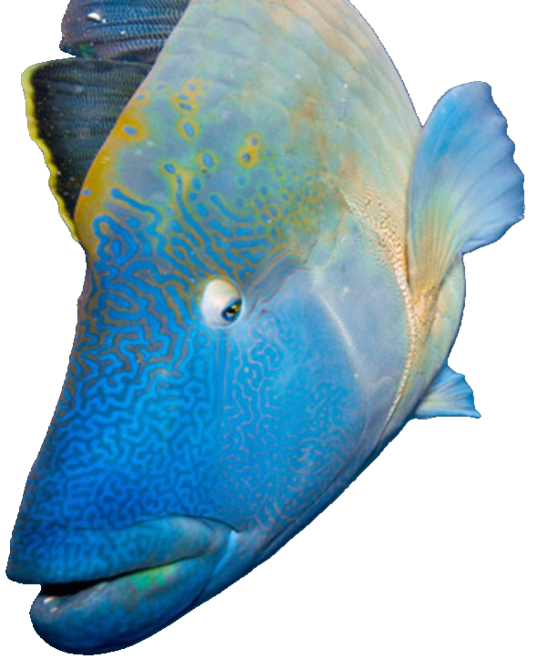

Will be?
trust, time & accuracy with benchmark!
Adjustments
Overrides
Consensus
Final
Accuracy
X⁺%
Forecast
Value Add
Forecast
Forecast
(Seasonal) Naïve
(Moving) average
Exp. smoothing
Arima
Forecast
low cost, fully automated
Data
Master data
Sales history
Data
Master data
Sales history
Promotions
Stock levels
Cleaning
Stock outs
Outliers
Demand vs Sales
Promotions
Stock levels
Forecast Cost
Notes:
Win trust, time, and accuracy.
I developed a 'System of Innovation,' a digital twin that provides a benchmark and quantifies accuracy without manual adjustments.
This system processes only a subset of our data.
Forecasts are generated immediately without any data cleansing using 'Australia's Next Top Model': the Fable Package, introduced in 2019.
Now, we can identify and minimize unnecessary and negative adjustments more effectively.

Slide 10
business understanding
Notes:
In this section we will see that we need forecasts to
- Plan production and Source materials
- Prevent stockouts and reduce waste.

Slide 11
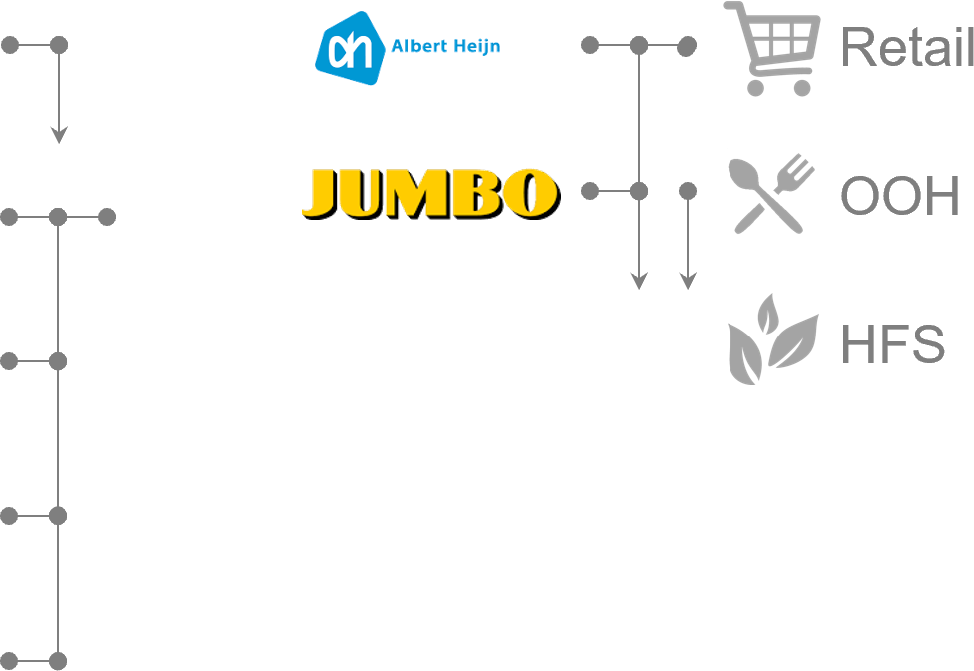
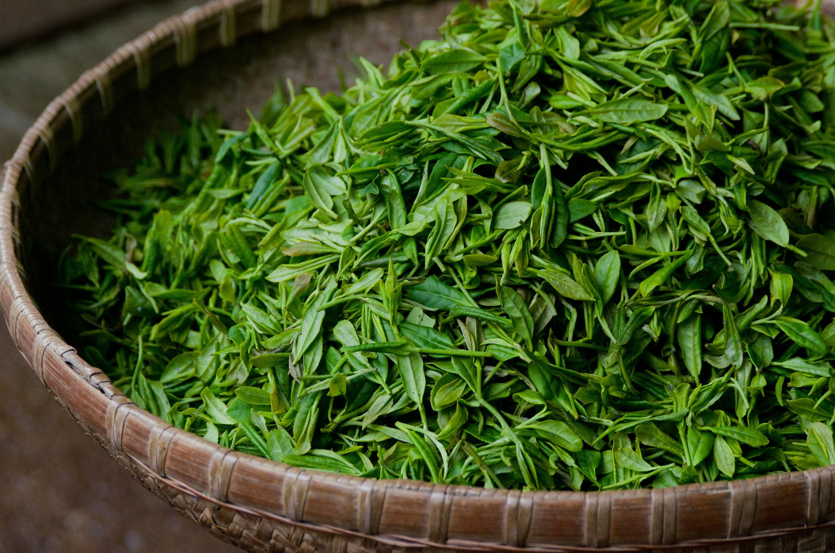
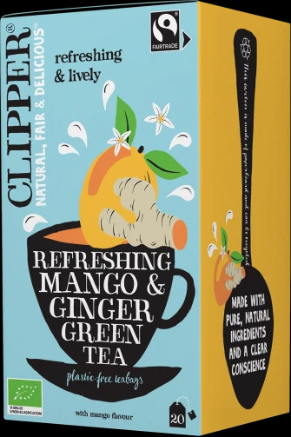








Why?
forecasts drive the business!
SOURCE
MAKE
DELIVER
-3 months
now
+12 months
now
+3 months
now
Shelf life > days Best
Before
Date
180
Out-of-Stock
120
60
< 60
Waste
Notes:
Why do we need forecasts?
Each package of Clipper tea we sell must be produced at least three months in advance.
making short-term forecasts crucial for efficient production planning.
Sourcing tea leaves involves negotiating contracts up to 12 months ahead,
which requires long-term forecasts.
Our customers, have unique shelf-life requirements, the days till expiration.
Premium retailers demand a shelf life of over 180 days paying a premium price,
discounters accept over 60 days.
Exceeding shelf life limits can result in lost sales, fines, delisting, and scrapping of products.
forecasts enable us to meet demand and reduce waste.

Slide 12











Who?
forecast usage varies by role!
 |  | Customers | Accounts | Channels
Brands |  |  |  | Retail
Category |  |  |  | OOH
Subcategory |  |  |  | HFS
Product Family
Article
Notes:
So, who uses these forecasts?
Product forecasts start the production in the ERP system.
Category and Brand managers use aggregated forecasts to plan marketing and sales strategies.
for Customer facing roles, the sales reps and Key account managers use forecasts for negotiations and manage expectations,
and all have a yearly target originating from forecasts.

Slide 13
data understanding
Notes:
Now, that we know the 'why’ and ‘who’ we can start exploring the data patterns..

Slide 14
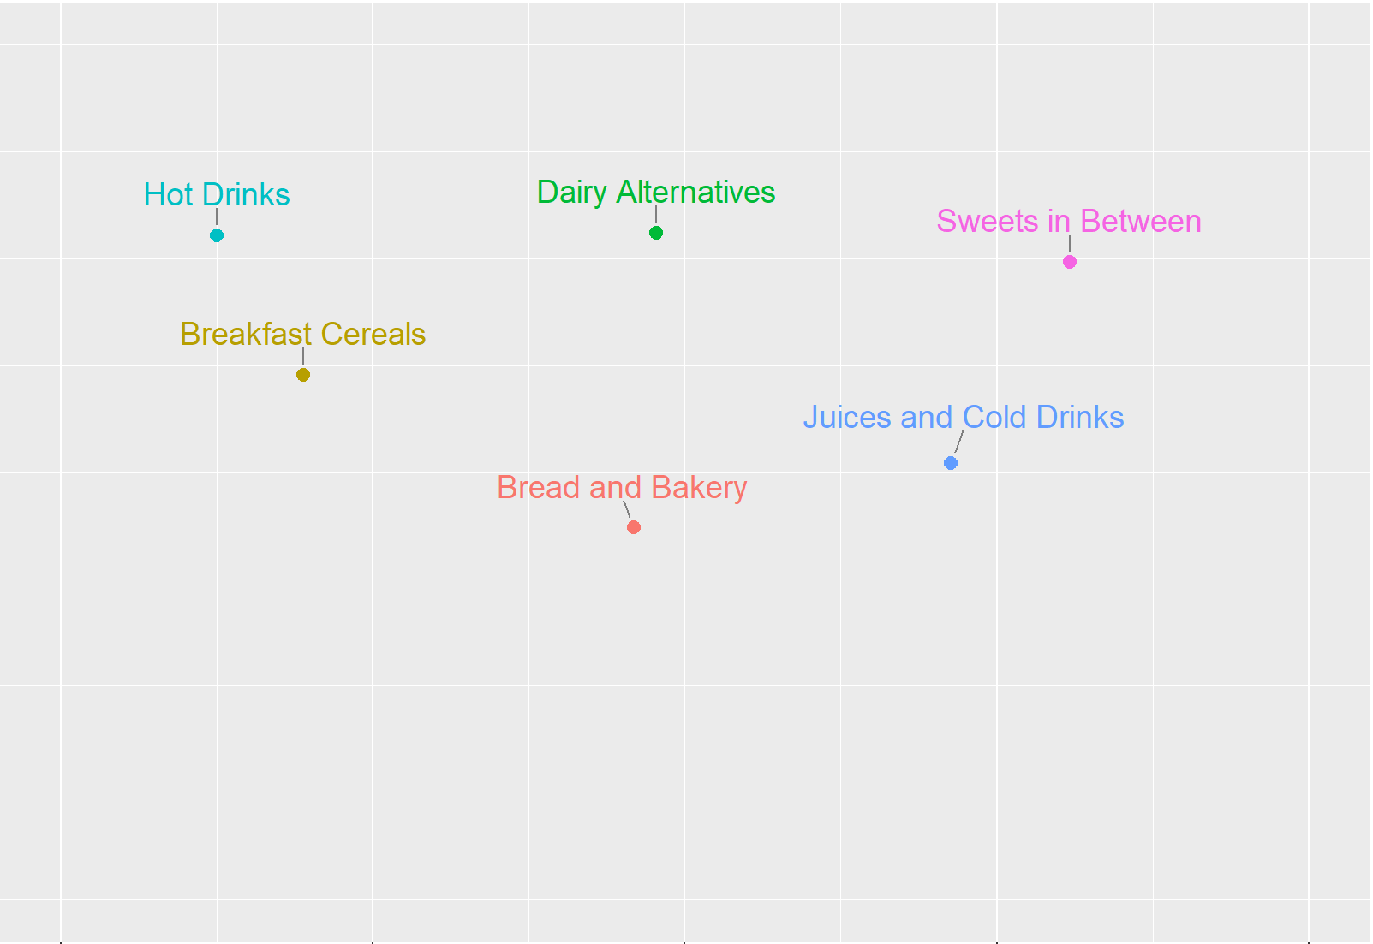
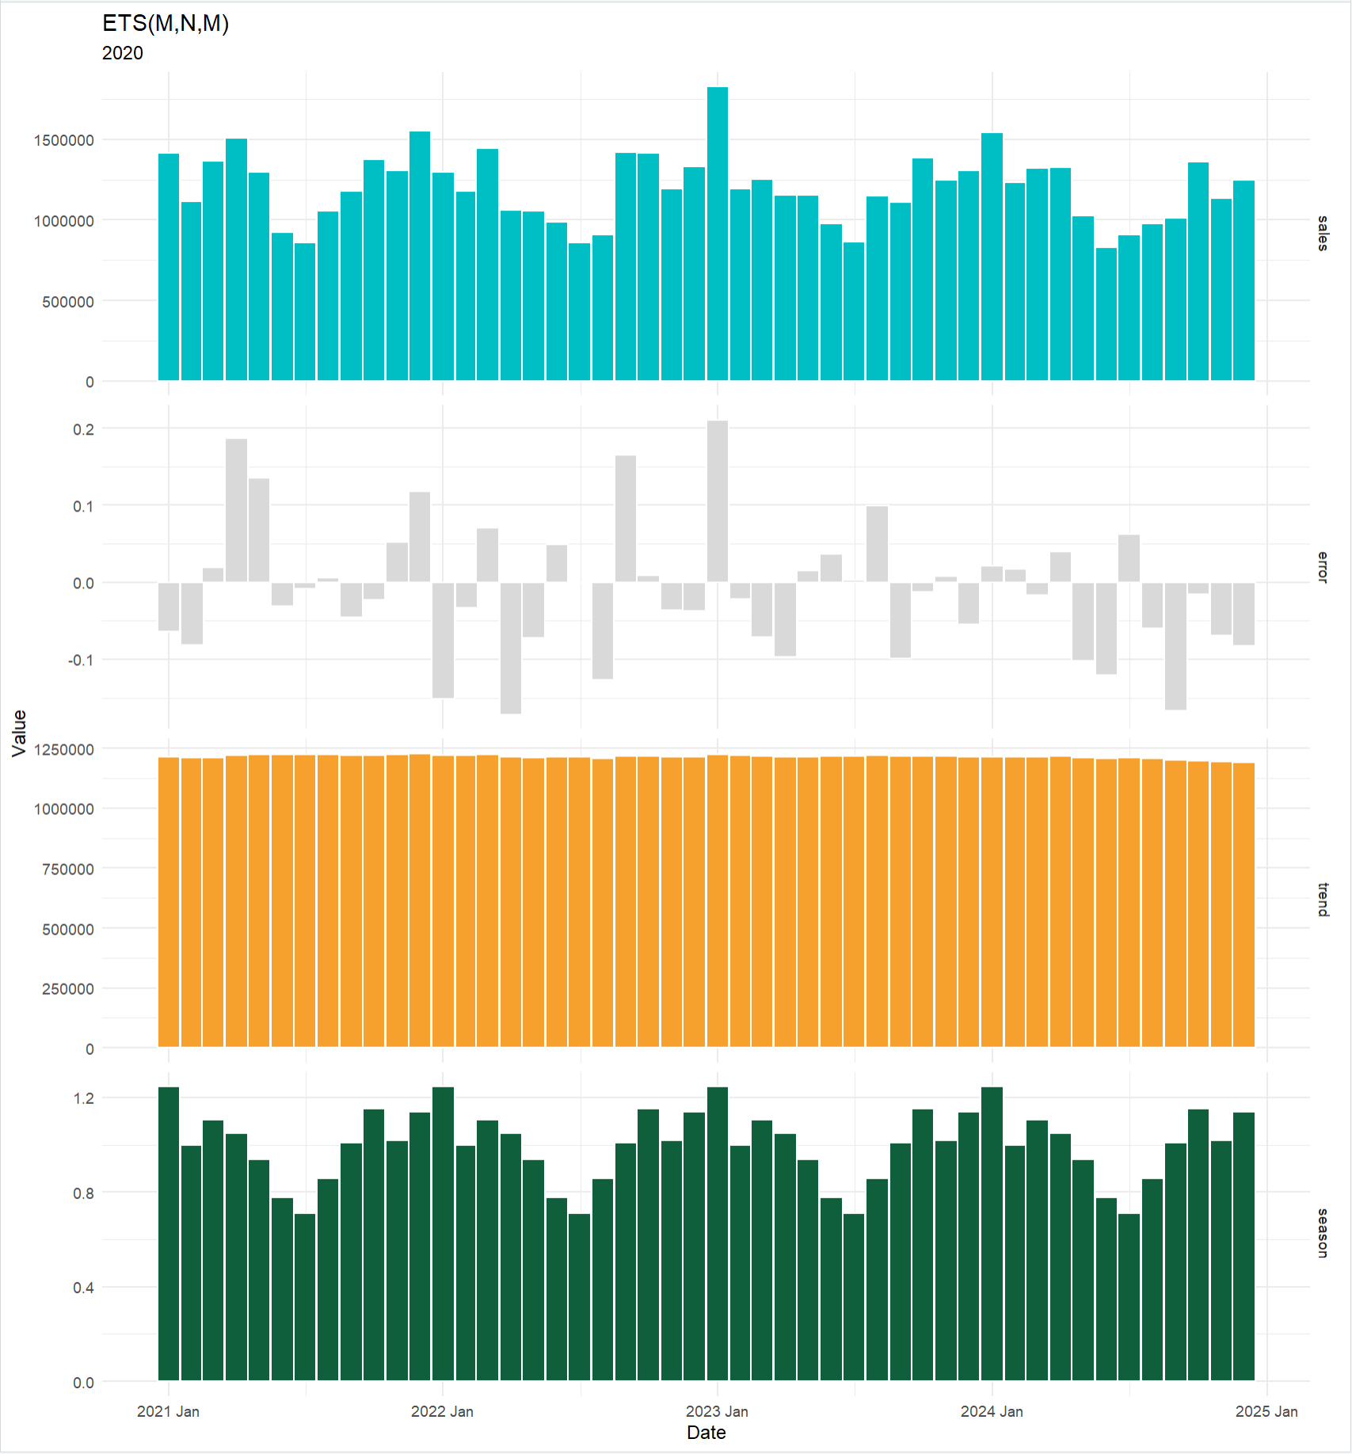
What?
time series patterns differ per category
Hot Drinks
Dairy Alternatives
Sweets in Between
Notes:
let’s explore the time series patterns per category
Which category is shown here?
the hot drinks category exhibits strong seasonality, as tea consumption increases during winter.

Slide 15
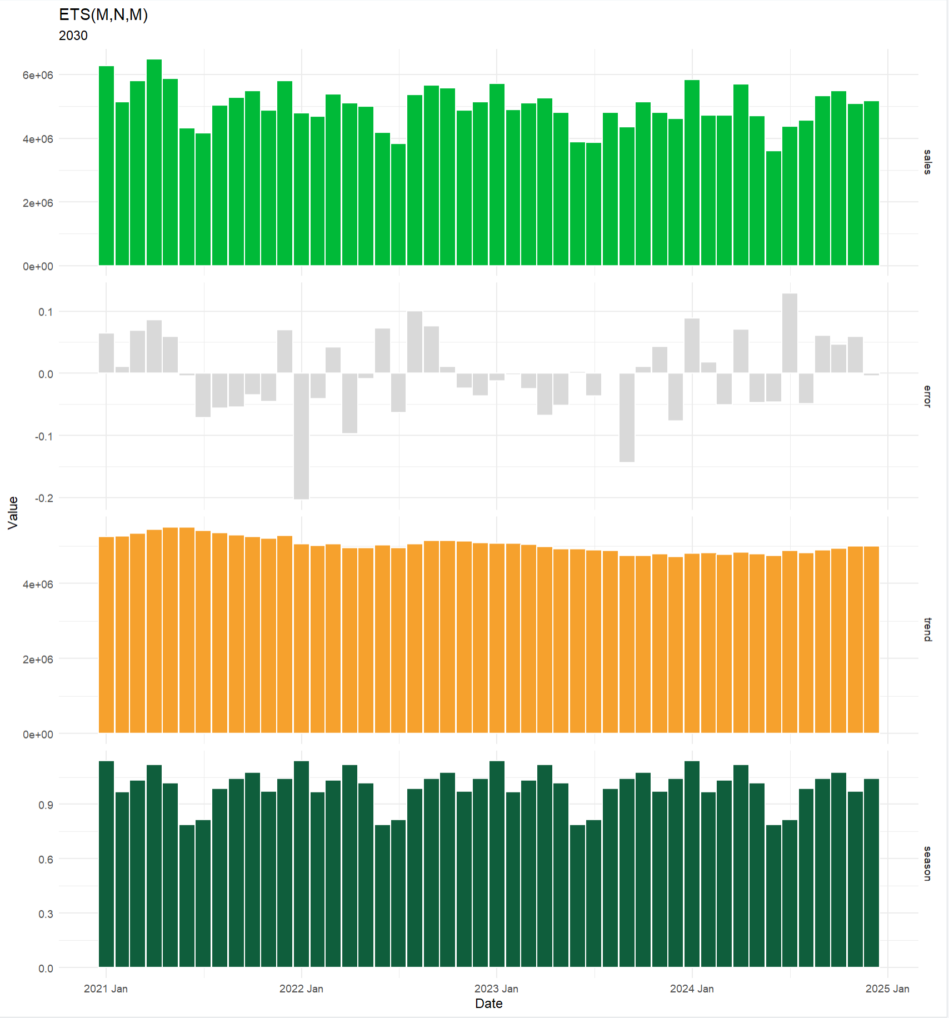
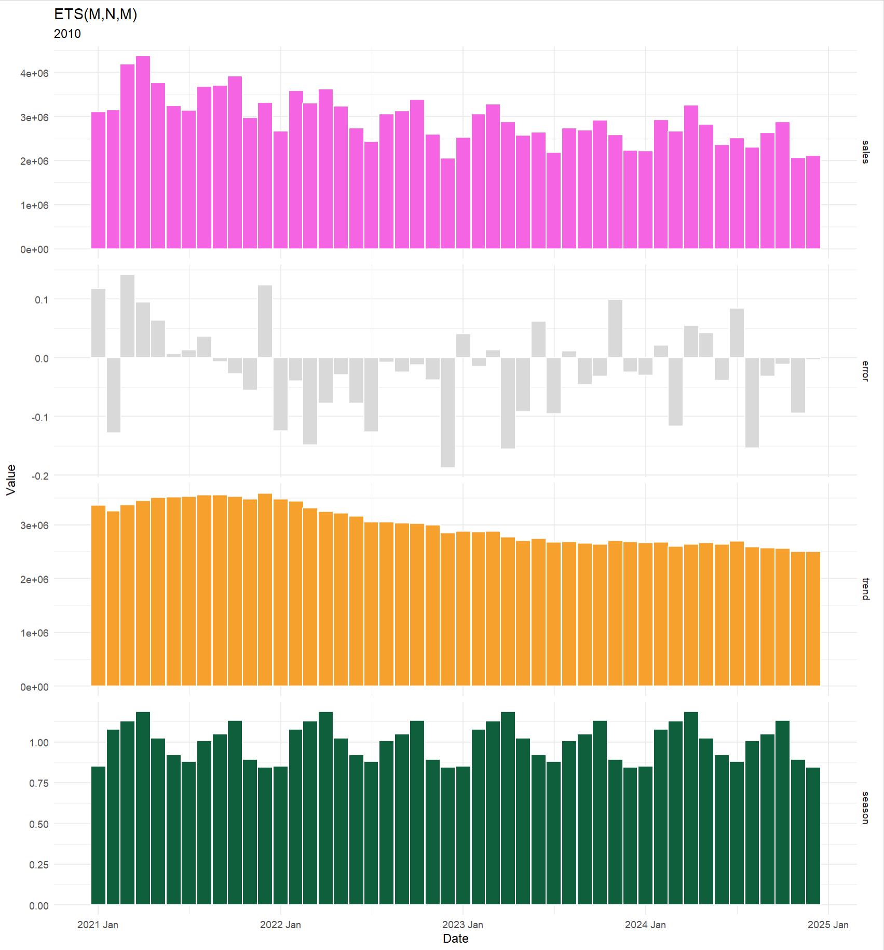

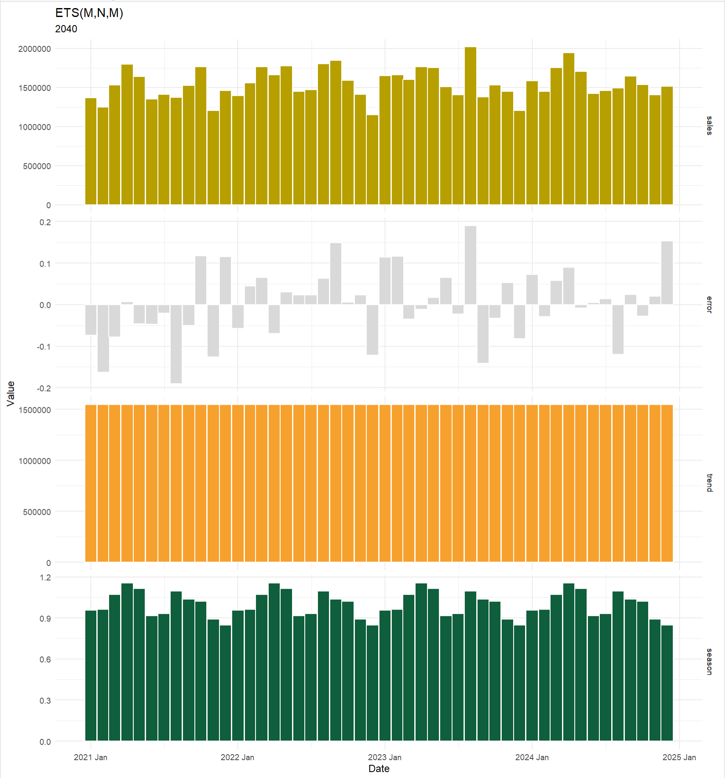

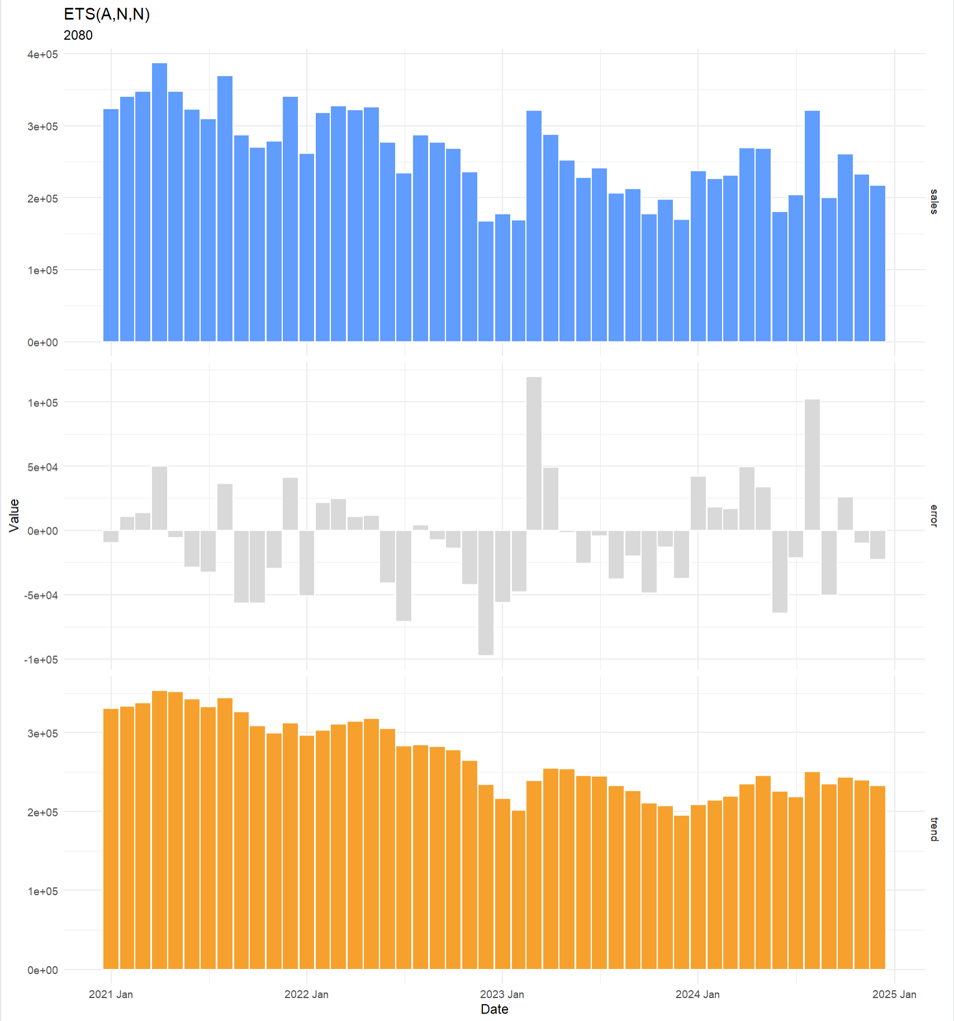
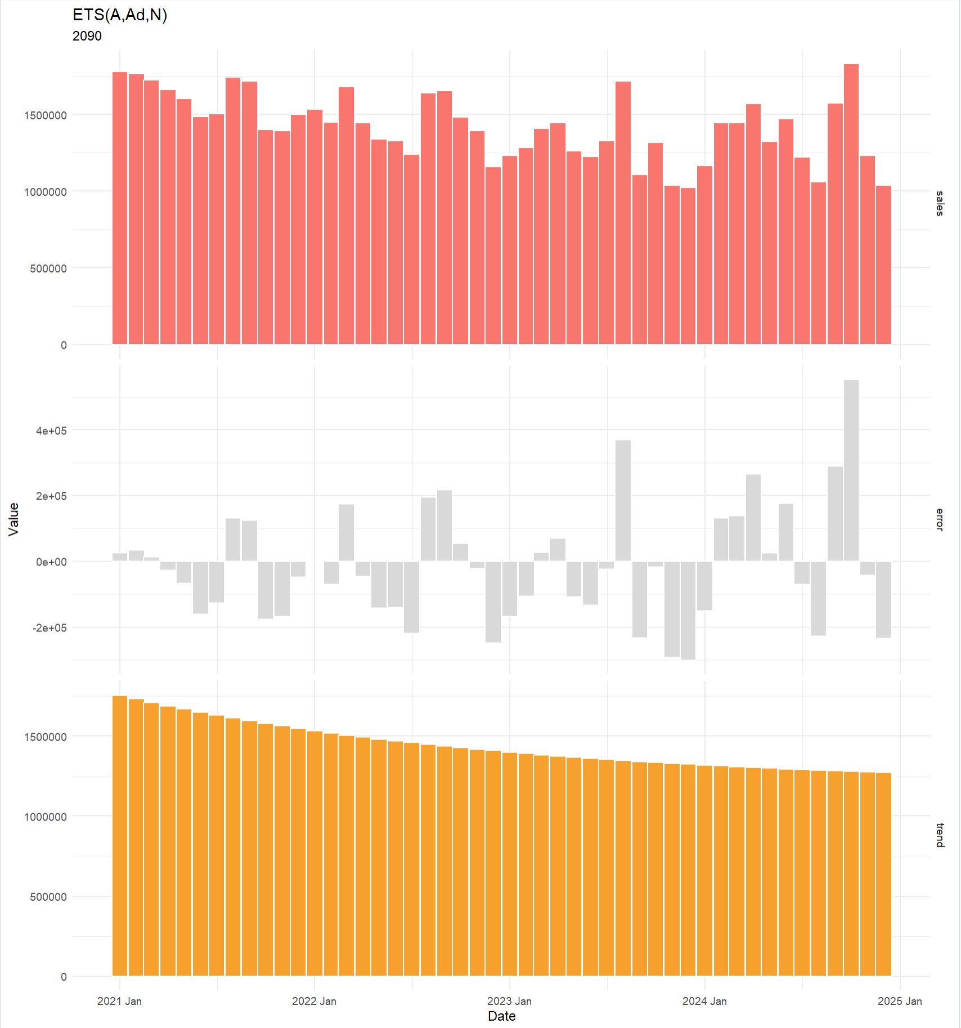

What?
time series patterns differ per category
Notes:
What other patterns do you see? Seasonality or trend?

Slide 16

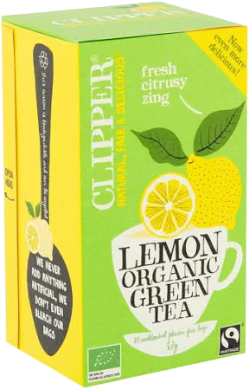
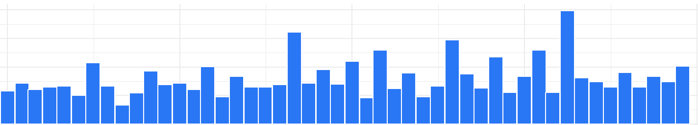
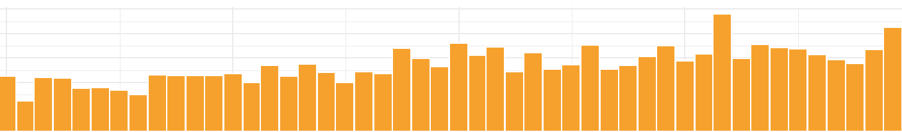
What?
aggregation clarifies, detail obscures!
 |  | Customers | Accounts | Channels
Brands
Category
Subcategory
Product Family
Article
hot drinks
Notes:
Identifying seasonality at the category level may seem straightforward,
but it becomes increasingly challenging at the article-retailer level,
and nearly impossible at the individual customer level.
This is where we need time series models.

Slide 17























What?
focusing on the vital few!
2024
650 M
2.500+ Articles
Notes:
Let's define the scope of the project by identifying the high-impact products.
In 2024, we recorded sales of over 2,500 unique products.
I narrowed my focus to the Market Sales Organization, which accounts for 50% of our global revenue,
reducing the number to approximately 800 products.

Slide 18
What?
products & organizations in scope!
2024
650 M
50%
800+ Articles
2.500+ Articles

Slide 19
What?
A-class products sold France!
2024
650 M
50%
38%
38%
A
B
C
160 Articles
800+ Articles
Notes:
Subsequently, I apply a Pareto analysis to identify around 160 products that represent 38% of our global revenue.

Slide 20
modelling
Notes:
Understanding our forecasting needs, we now turn to the modelling process.

Slide 21

With?
glassbox models for building trust!
 |  | Customers | Accounts | Channels
Brands |  | <Method> | … | <Method>
Category |  | … | … | …
Subcategory |  | … | <Method> | …
Product Family |  | … | … | …
Article |  | <Method> | … | …
Notes:
We require forecasts across various levels, each potentially demanding distinct methods.

Slide 22
Long Short Time Memory
time GPT
Recurring Neural Networks
Notes:
Initially, I considered using LSTM or foundational models like TimeGPT, blackbox models. We know the input and see the output, but this is difficult to explain.

Slide 23
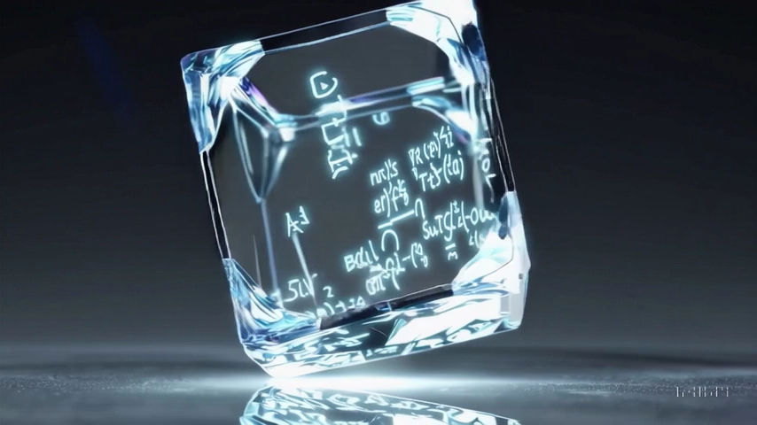
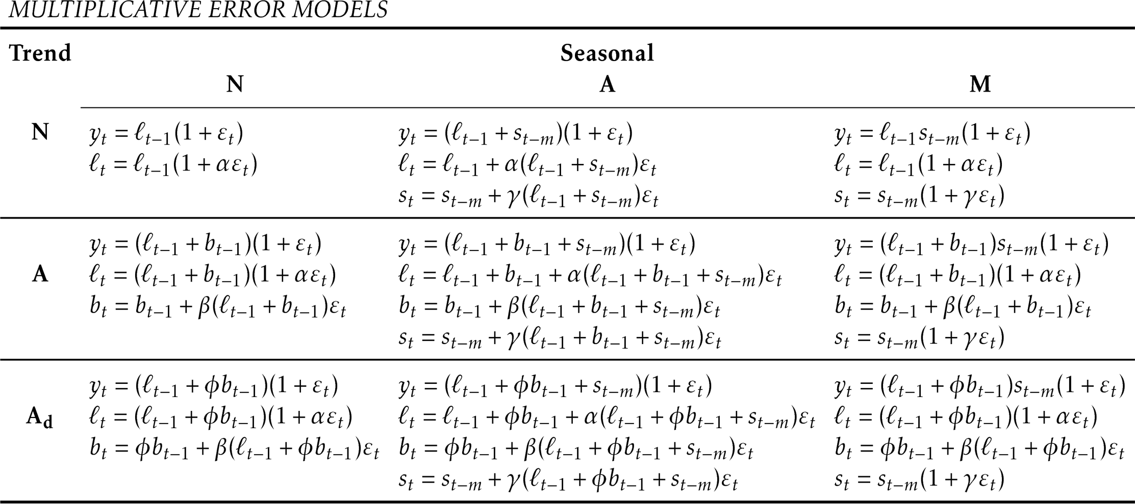
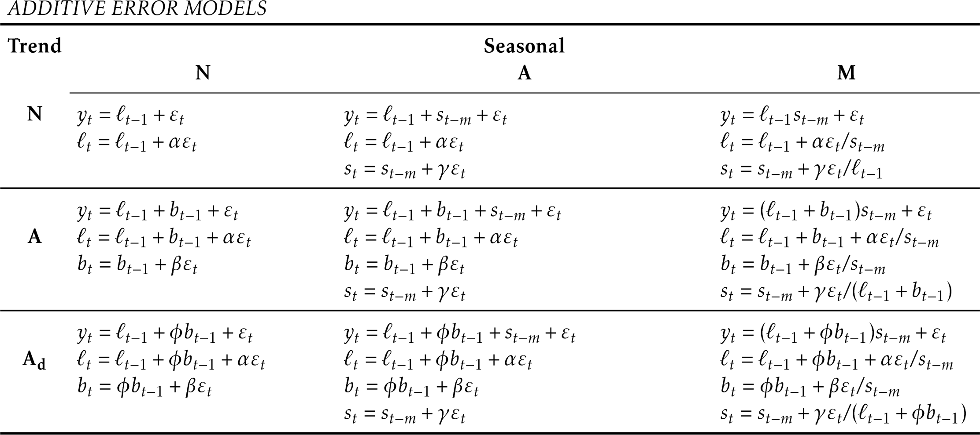
ETS?
Error – Trend - Season
ETS(A, .., …)
ETS(M, .., …)
18 Models
Automatically selected
Prediction intervals
ETS(.., A_{d}, …)
ETS(.., .., M)
Glass Box Model made with sora
Hyndman, R.J., & Athanasopoulos, G. (2018) Forecasting: principles and practice, 2nd edition, OTexts: Melbourne, Australia. OTexts.com/fpp2
Notes:
Trust, by explainable outcomes can be realized by glassbox models, like
E-T-S, Error-Trend-Season is exponential smoothing on steroids,
It fully discloses its formulas and selected hyperparameters,
making it easier to understand and justify its results.
E-T-S selects automatically the best model out of 18, and
generates prediction intervals to explain uncertainty.

Slide 24
With?
ETS, innovations state space models!
 |  | Customers | Accounts | Channels
Brands |  | <Method> | … | <Method>
Category |  | … | … | …
Subcategory |  | … | <Method> | …
Product Family |  | … | … | …
Article |  | <Method> | … | …
Notes:
To simplify the selection process of forecasting method across different aggregation levels,
we've adopted E-T-S, at all levels:
One METHOD fits all!

Slide 25
With?
ETS, one method fits all!
 |  | Customers | Accounts | Channels
Brands |  | ETS | … | ETS
Category |  | … | … | …
Subcategory |  | … | ETS | …
Product Family |  | … | … | …
Article |  | ETS | … | …

Slide 26
With?
time series classified by its features
Strength
Seasonal
Trend Strength
Notes:
Using Time series features, categories can be automatically classified
in the upper left corner, Clipper hot again, demonstrating the expected seasonality-strength.

Slide 27
With?
decomposition in Error, Trend, Season!

Slide 28
With?
decomposition in Error, Trend, Season!
A
A
M
ERROR
A_{d}
N
N
TREND
N
N
M
SEASON
Notes:
By decomposing, E-T-S reveals the distinct internal components: Error, Trend, and Season.
”Juices and Cold drinks”, Display no trends or seasonality, leading to flat forecasts.
“Bread and Bakery”, Shows a damped downward trend.
Surprisingly, "Sweets in between" Exhibit a seasonal pattern, who knows why?
This, as they are popular healthy snacks for children, with school holidays marking the low season.

Slide 29
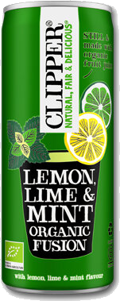


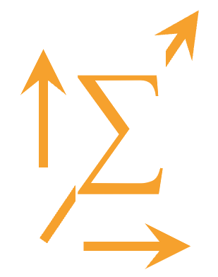
With?
Single level approach may cause inaccuracies!
 |  | Customers | Accounts | Channels
Brands
Category
Subcategory
Product Family
Article
Top down
ETS(A, N, N)
actuals
forecast
%
cold drinks
ETS(A, N, M)
hot drinks
%
ETS(A, N, N)
Bottom Up
Notes:
Creating coherent forecasts across various levels from a single forecast creates challenges, for example:
The Bottom-up approach, forecasts at detailed levels to be aggregated, however data may be too noisy to identify clear patterns.
The top-down approach, forecasts at aggregated levels, to be distributed however, Seasonal patterns may neutralize each other and disappear, resulting in poor accuracy.

Slide 30
With?
HTS, coherent Hierarchical forecasts!
 |  | Customers | Accounts | Channels
Brands
Category
Subcategory
Product Family
Article
Data
Master data
Sales history
∑
HTS
ETS(A, N, M)
ETS(A, A_{d}, M)
Ordinary Least Squares
forecast
ETS(A, N, N)
Notes:
To ensure coherent forecasts across all levels, we use hierarchical forecasting techniques, leveraging our master data structure.
We utilize 'ordinary least squares' for reconciliation,
which produces detailed and reliable forecasts that remain coherent when aggregated.

Slide 31
evaluation
Notes:
Evaluation!
Well, the proof of the pudding is in the eating, let's evaluate the results.

Slide 32
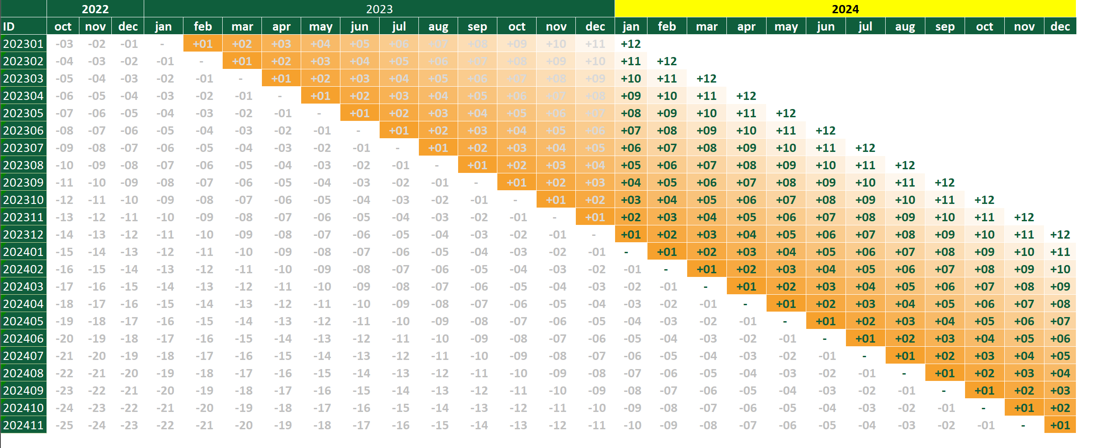
When?
rolling windows, time series Cross-Validation!
actuals
train
forecast
test
Notes:
To accurately assess our forecasting capabilities,
we use a rolling window approach with a 12-month forecast horizon.
This method enables us to measure forecast accuracy month-by-month,
providing detailed insights into our predictive precision at various future intervals.

Slide 33
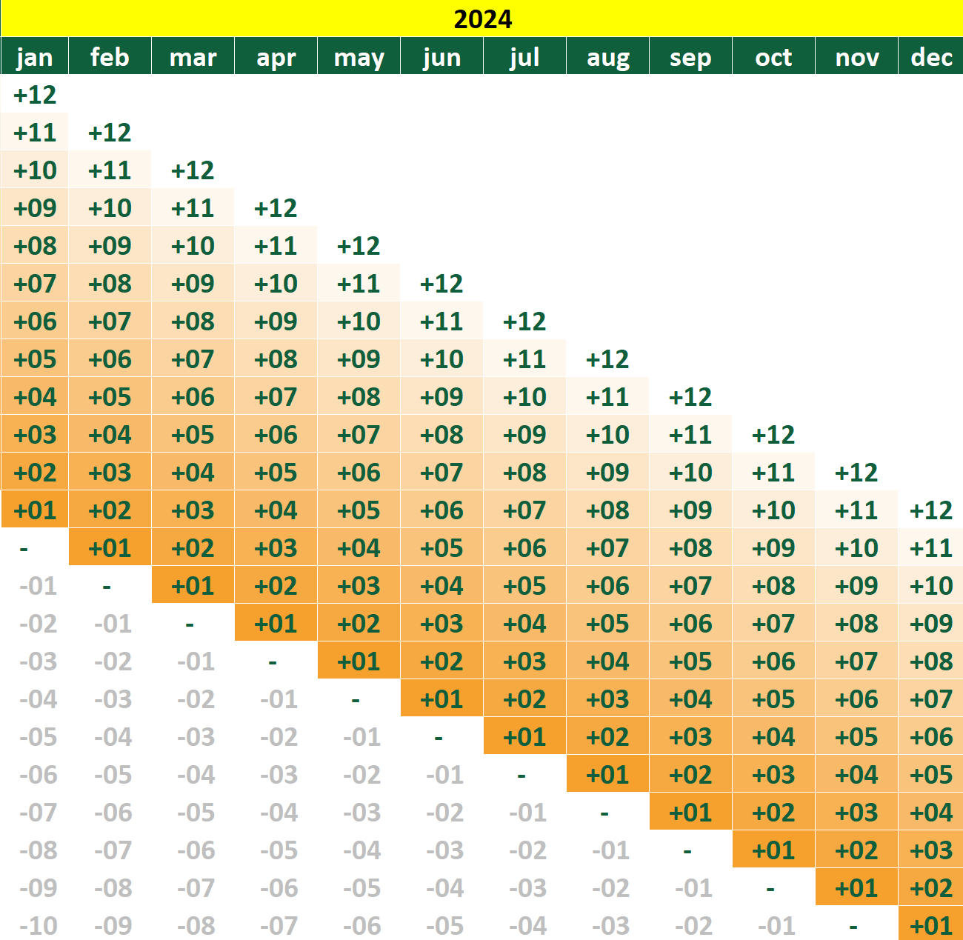


When?
assessing short- & long-term accuracy!
now
+12 months
SOURCE
now
+3 months
MAKE
$$RMAE=\sum_{{mat}_{1}}^{{mat}_{N}}{\frac{{\hat{y}}_{t}− \left|{\hat{y}}_{t}−y_{t}\right|}{{\hat{y}}_{t}}}$$
$$RMAE=\sum_{{mat}_{1}}^{{mat}_{N}}{\frac{y_{t}− \left|{\hat{y}}_{t}−y_{t}\right|}{y_{t}}}$$
Notes:
Note that we measure both the short-term, 3-month forecast required for production,
and the long-term, 12-month forecast needed for sourcing and setting targets.

Slide 34
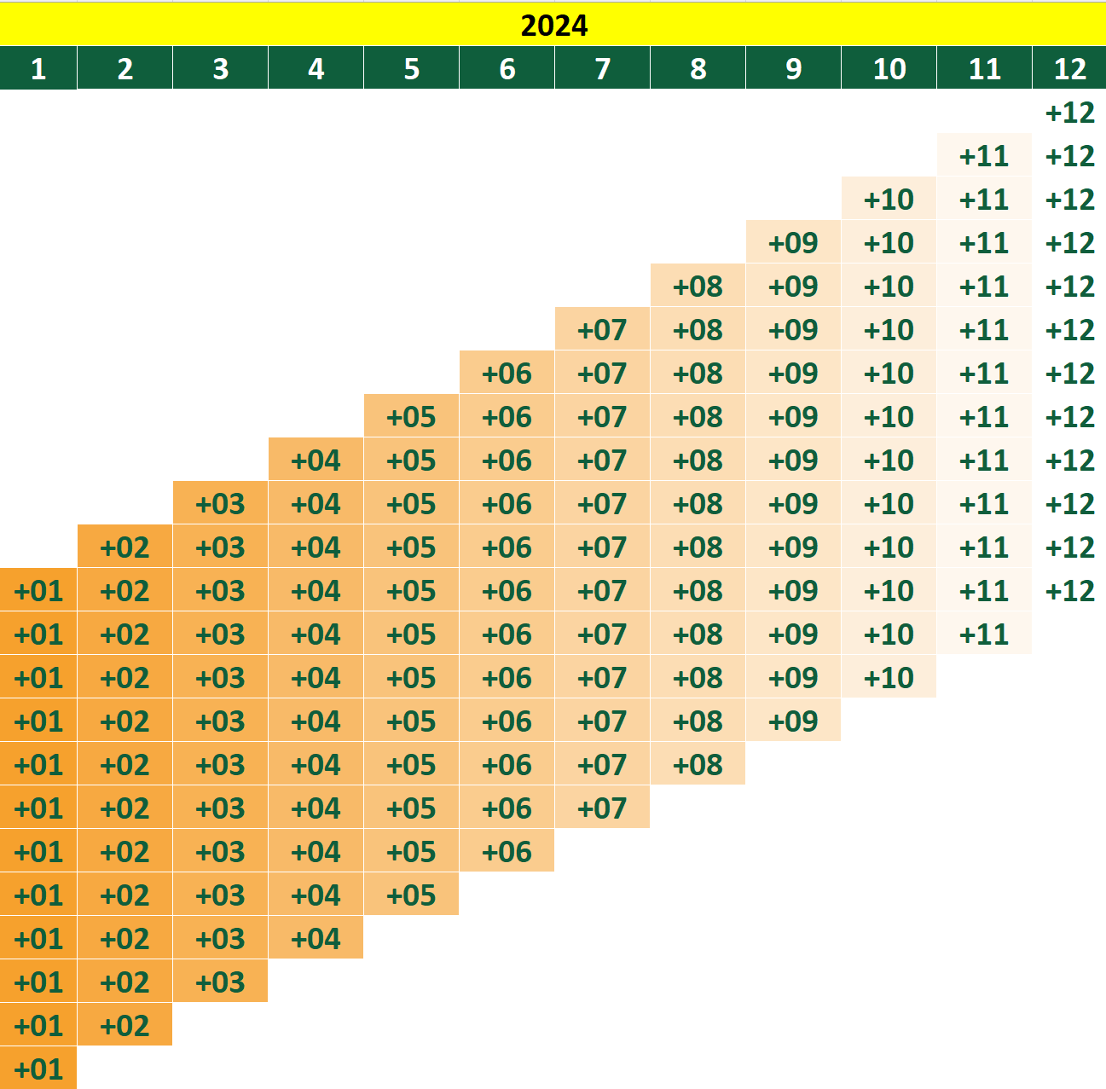
When?
assessing short- & long-term accuracy!
now
+12 months
SOURCE
now
+3 months
MAKE
$$RMAE=\sum_{{mat}_{1}}^{{mat}_{N}}{\frac{{\hat{y}}_{t}− \left|{\hat{y}}_{t}−y_{t}\right|}{{\hat{y}}_{t}}}$$
$$RMAE=\sum_{{mat}_{1}}^{{mat}_{N}}{\frac{y_{t}− \left|{\hat{y}}_{t}−y_{t}\right|}{y_{t}}}$$
Notes:
We derive the Root Mean Squared Error from 12 measurements per horizon,
as detailed in the following slide.

Slide 35
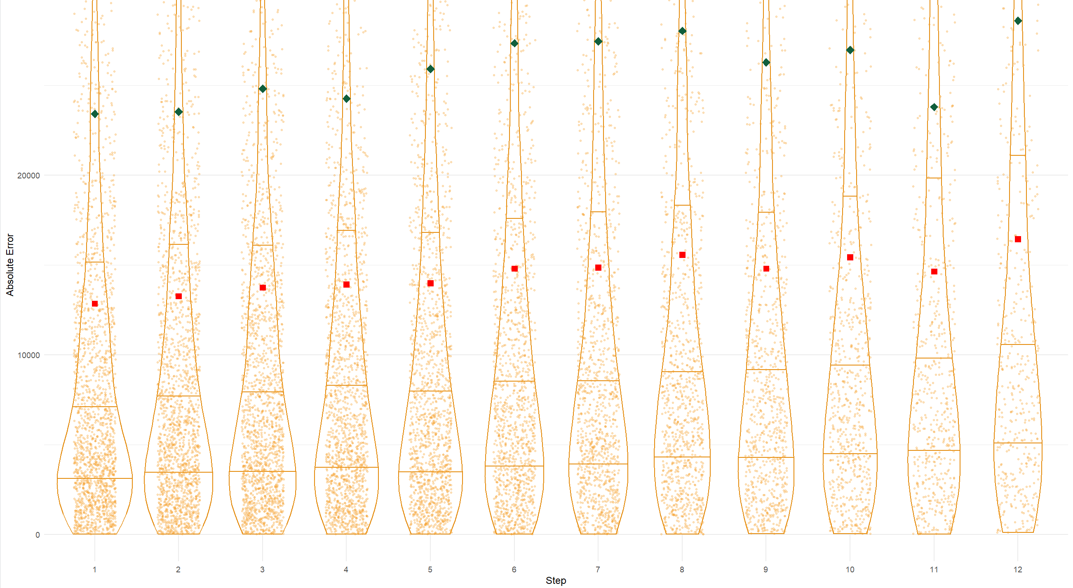
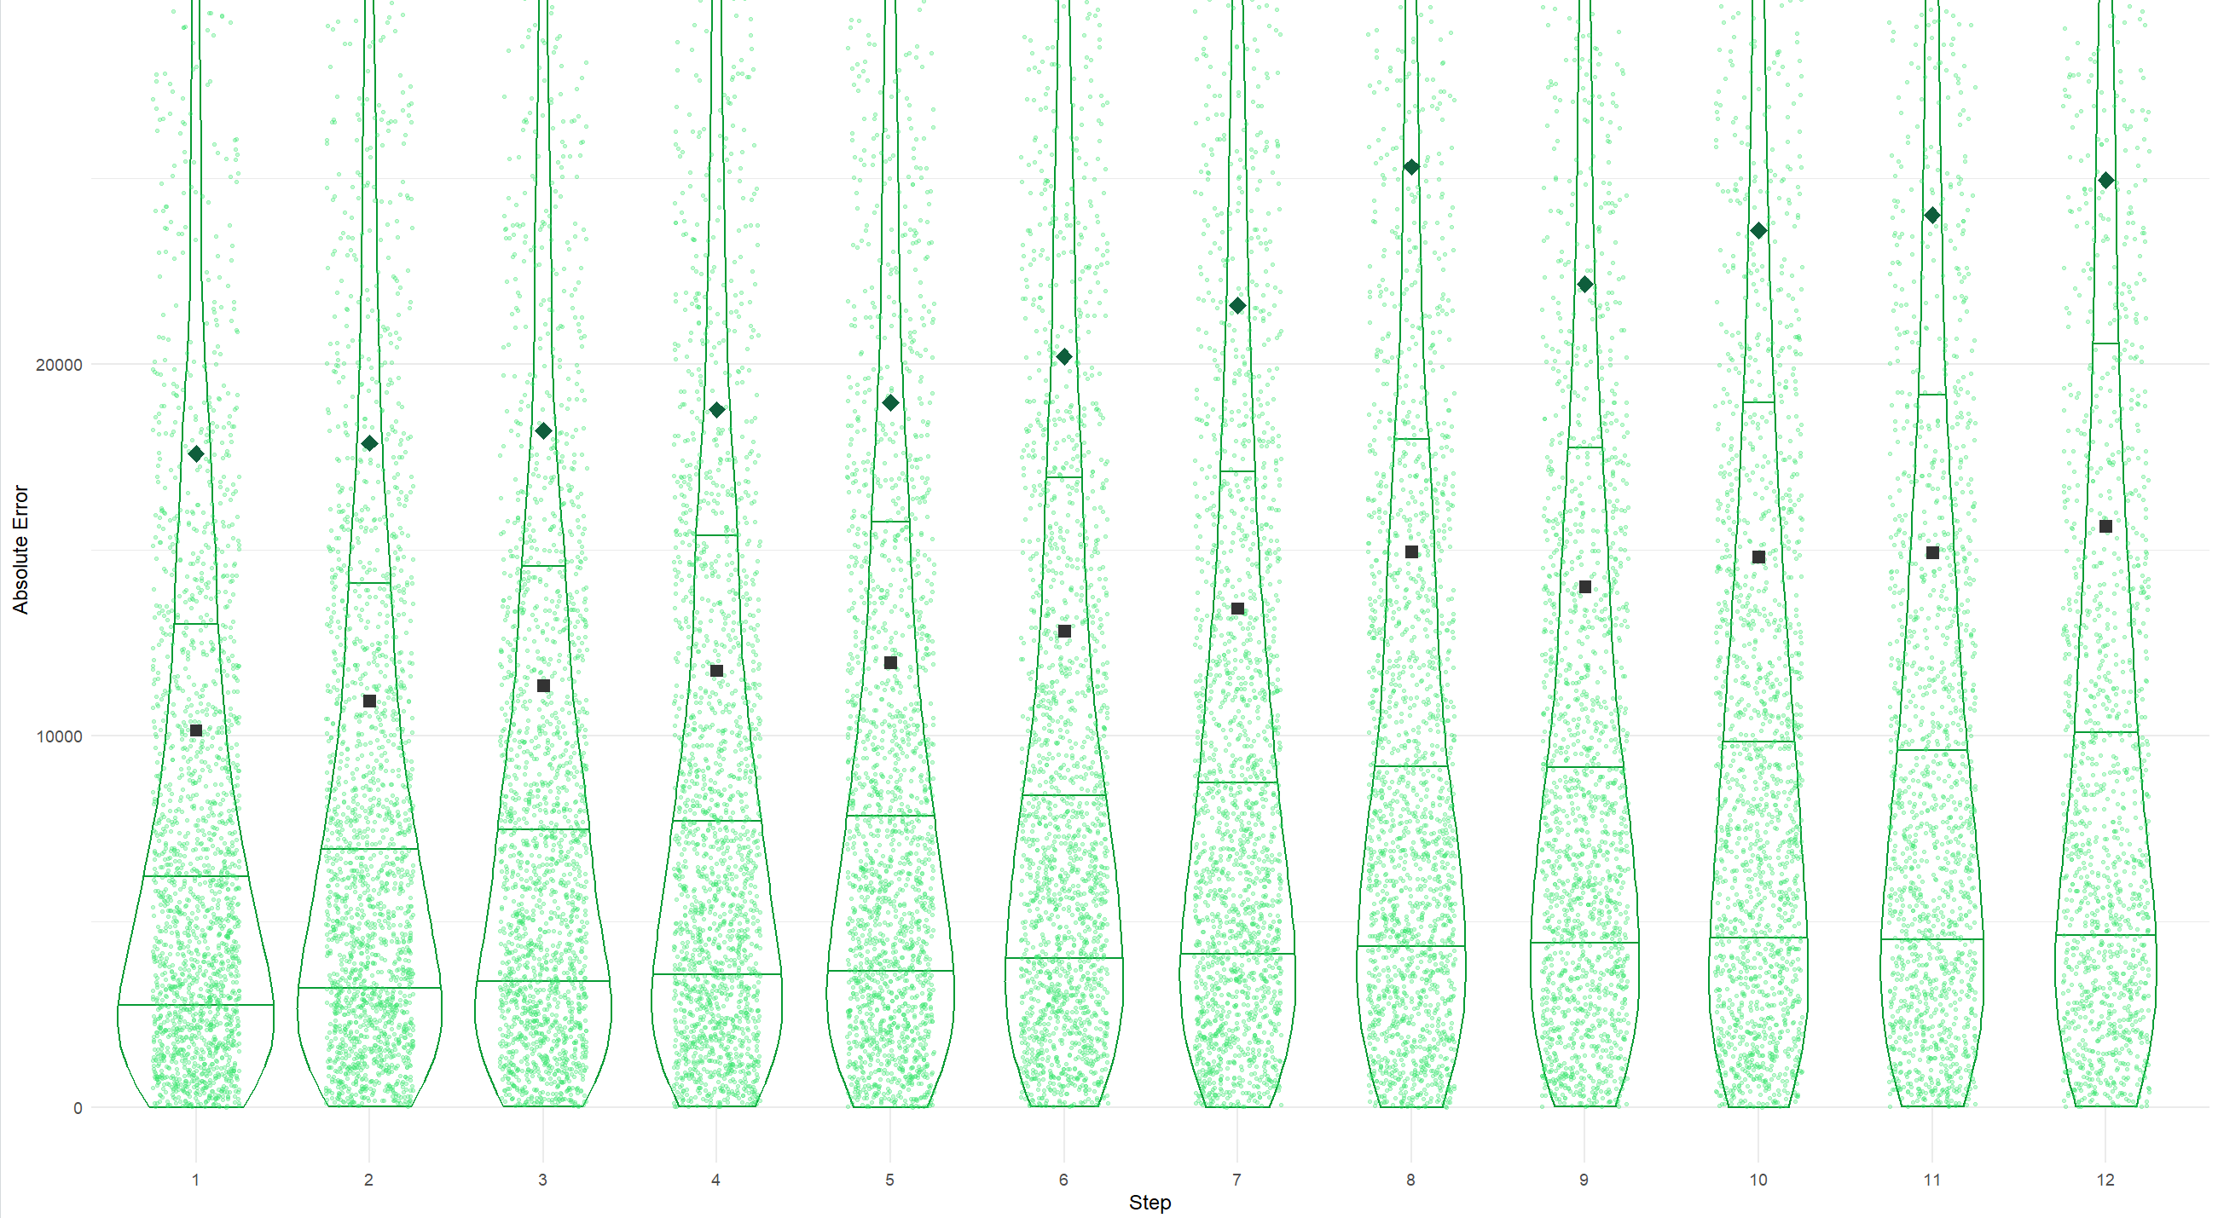
Which?
Original system against Pythia’s Advice!
MAKE
SOURCE
Notes:
This slide reveals the forecast errors of our existing forecasting system.
Interestingly,
the results of our digital twin show almost no change, despite excluding promotions and stock levels, and skipping cleaning the sales.
Furthermore, the models were automatically selected, and we didn’t make any manual adjustments.

Slide 36
Win?
trust, time, and forecast accuracy!
Adjustments
Overrides
Consensus
Final
Accuracy
3⁺%
Forecast
Value Add
X
3
%
Forecast
Forecast
Data
Master data
Sales history
Forecast Cost
Notes:
When we consolidate all data and calculate forecast accuracy as in the original system,
we find a Forecast Value Add of 3%..
Now, we need to build trust to minimize the many minor tweaks that reduces accuracy.

Slide 37
deployment
Notes:
Deployment!
To maximize forecast value, let’s see how we plan to deploy the results.

Slide 38

Which?
Outperforming Pythia’s Advice Benchmark!
beat the nerd in the corner
Created with: DALL E-3
Source: Michael Gilliland SAS, Forecast Value Added Analysis: Why and How, ISF 2019
Notes:
We will launch 'Beat the Nerd in the Corner,' a game designed to enhance forecast accuracy.
Demand planners need to outperform the forecast set by Pythia’s Advice,
identifying which adjustments improve or diminish accuracy.
This method fosters both trust and engagement

Slide 39
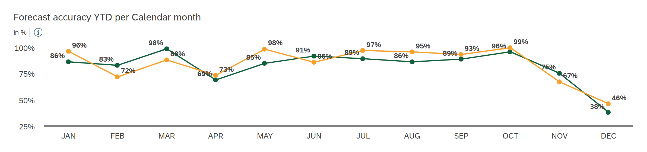
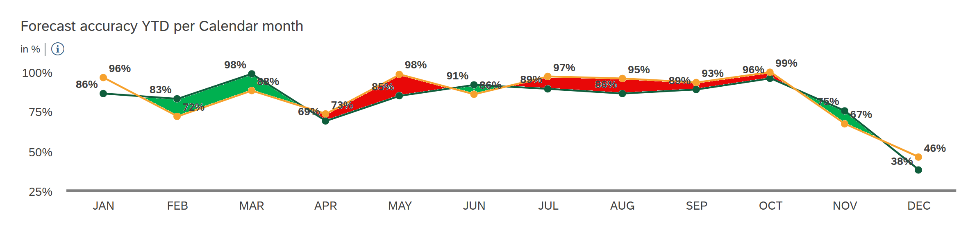
Which?
Outperforming Pythia’s Advice Benchmark!
Notes:
Pythia’s Advice will serve as a benchmark in our existing accuracy monitoring system.

Slide 40
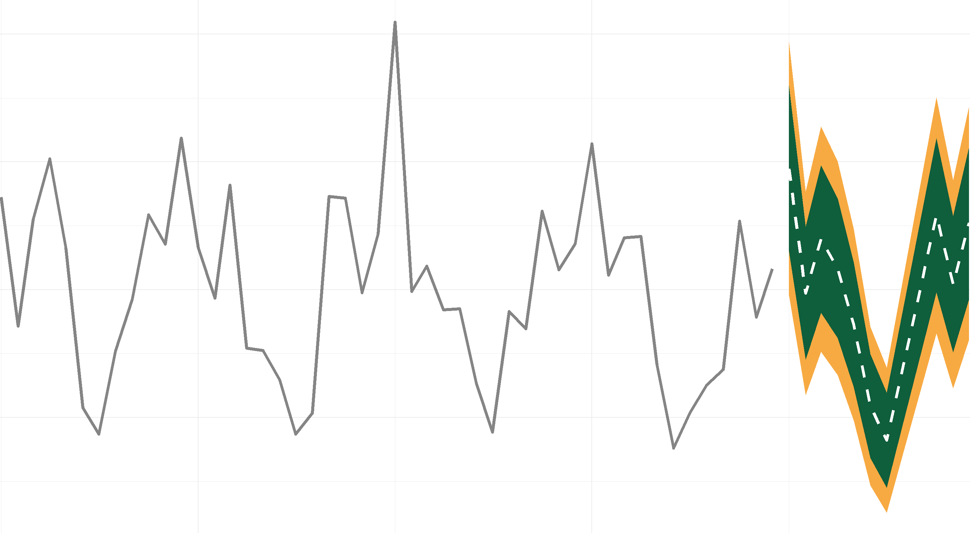
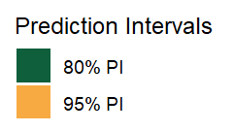
Where?
preventing Stock-Outs and minimizing Waste!
Notes:
To truly derive value from our forecasts, we will start using prediction intervals from E-T-S to determine safety stock levels.
This method ensures Pythia's Advice will boost sales by preventing stock-outs and minimizing waste.
This was the ultimate Goal of the Pythia's advice research project!

Slide 41

Where?
reducing Stock-Outs and minimizing Waste!
Out-of-Stock
Waste
Notes:
To truly derive value from our forecasts, we will start using prediction intervals from E-T-S to determine safety stock levels.
This method ensures Pythia's Advice will boost sales by preventing stock-outs and minimizing waste.
This was the ultimate Goal of the Pythia's advice research project!

Slide 42

“Standing on the shoulders of GIANTS”
Hyndman, R. J., Koehler, A. B., Grose, S., & Snyder, R. D, (2002). “A state space framework for automatic forecasting using exponential smoothing methods.” International Journal of Forecasting 18(3): 439–454.
Notes:
IIF Fellow Ralph Snyder

Slide 43
Trust
is all you need

Slide 44
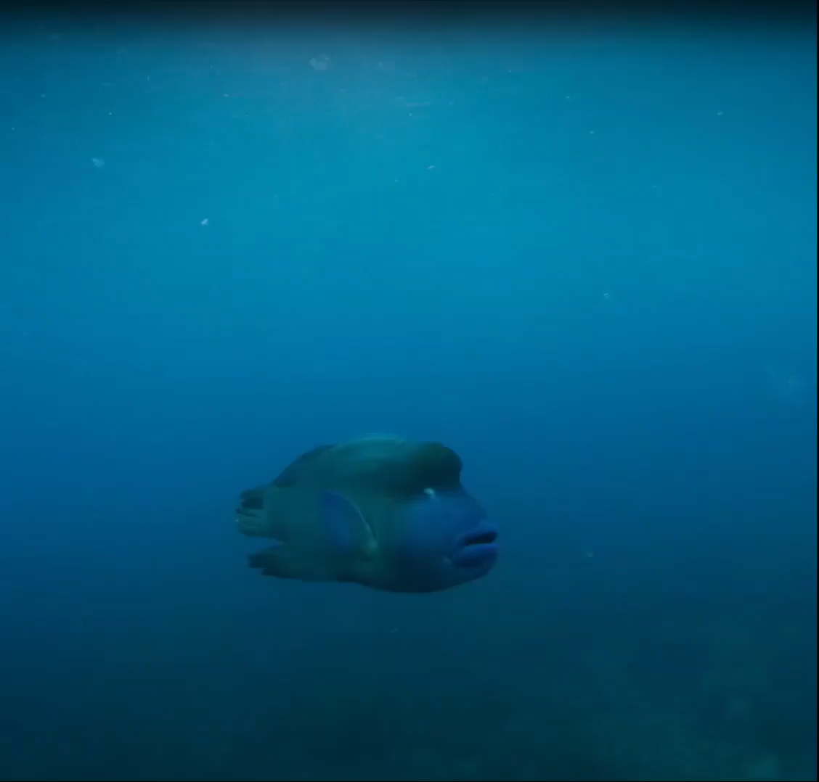
Pythia’s Advice credits:
Ieke le Blanc
Daniel Kapitan, Joran Lokkerbol, Pieter Overdevest
Nina, Merel, Sandra
EAISI
Floris Padt
Monash University
-Melbourne-
Hyndman, R.J., & Athanasopoulos, G,
et al.
Alex Teeuwen
How to speak:
Conor Neill
David JP Philips
Simon Lancaster
Andrew Tarvin
Great Barrier Reef
- Wally the Wrasse –
MacGillivray Freeman
Music: John Rowcroft
AI Claude & ChatGPT
Sora & Dalle E3
Obi-Wan Kenobi
test

